Slide 1
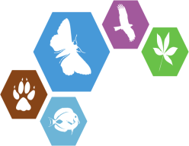

Revolution in publication:
Data and text publishing integrated in the
Biodiversity Data Journal
Lyubomir Penev, Teodor Georgiev, Pavel Stoev, Jordan Biserkov, Laurence Livermore, Jeremy Miller, David Roberts, Vincent Smith
Biodiversity Informatics Horizons 2020
September 3-6, 2013, Rome
ViBRANT

Slide 2

Revolution?
Again??

Slide 3

…but if there is a bottleneck, then expect a revolution!

Slide 4
The “Publishing Bottleneck in Biodiversity”?
What is that?

Slide 5
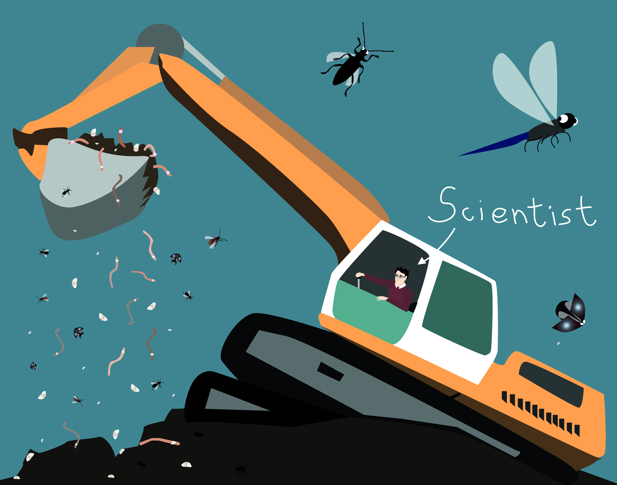
Massive sampling/data gathering

Slide 6
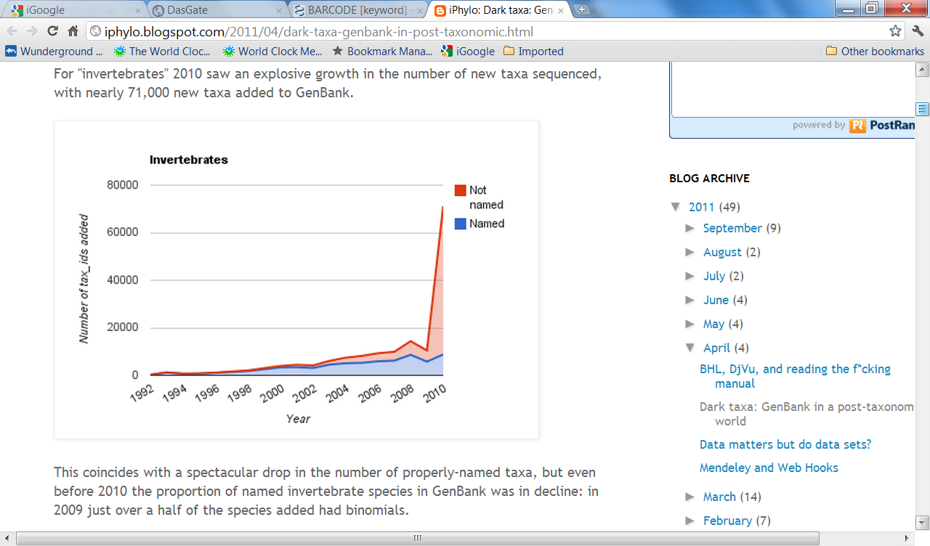
‘Dark Taxa’ increase dramatically!
Rod Page, iPhylo blogspot, 12 April 2011

Slide 7

The paper/PDF impediment

Slide 8
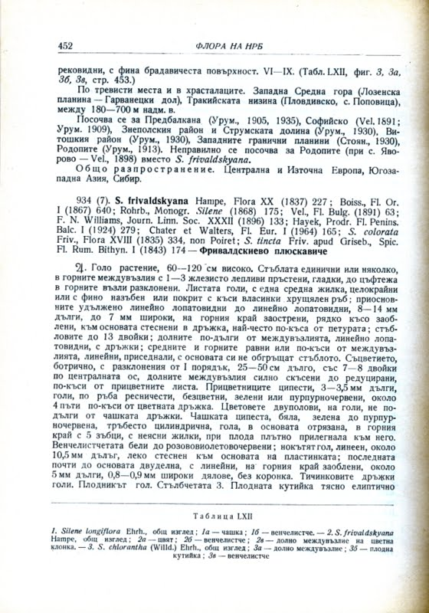
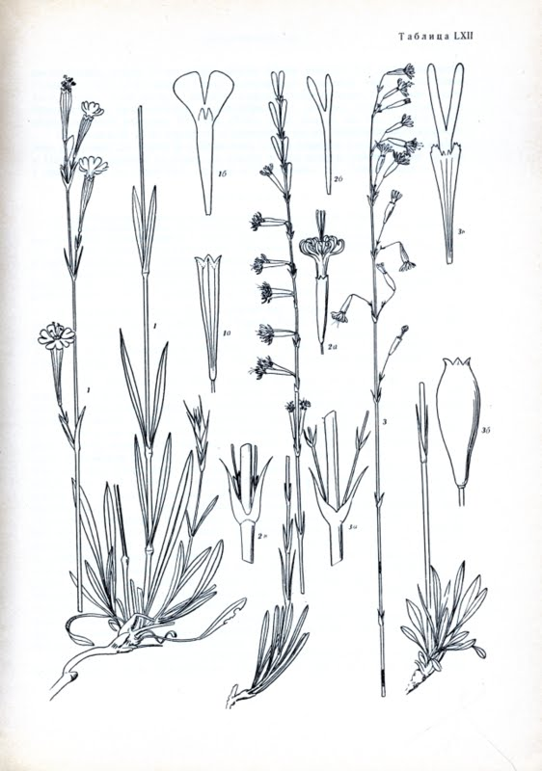
… the burden or OCR, double-keying and markup of paper/PDF literature

Slide 9
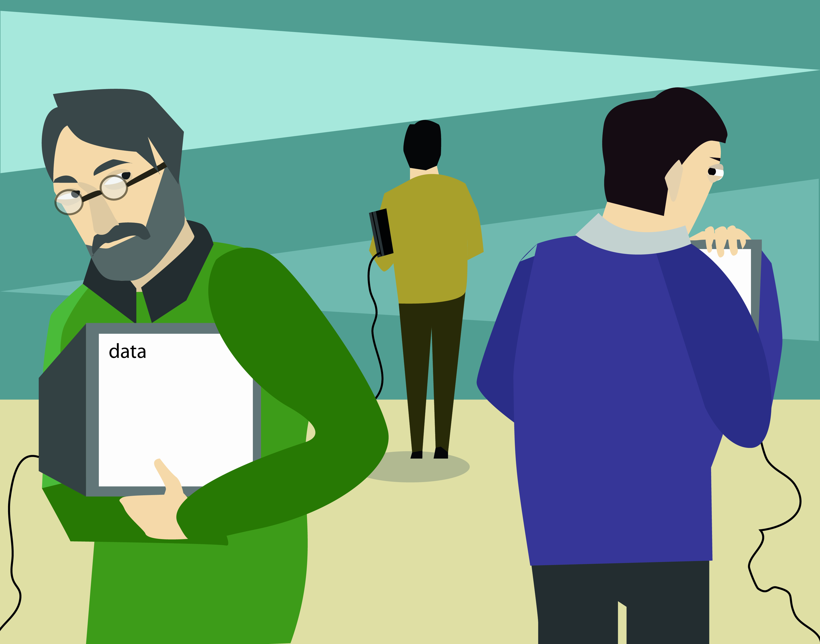
Low uptake of open data publishing/sharing

Slide 10

The “impact factor” pressure

Slide 11
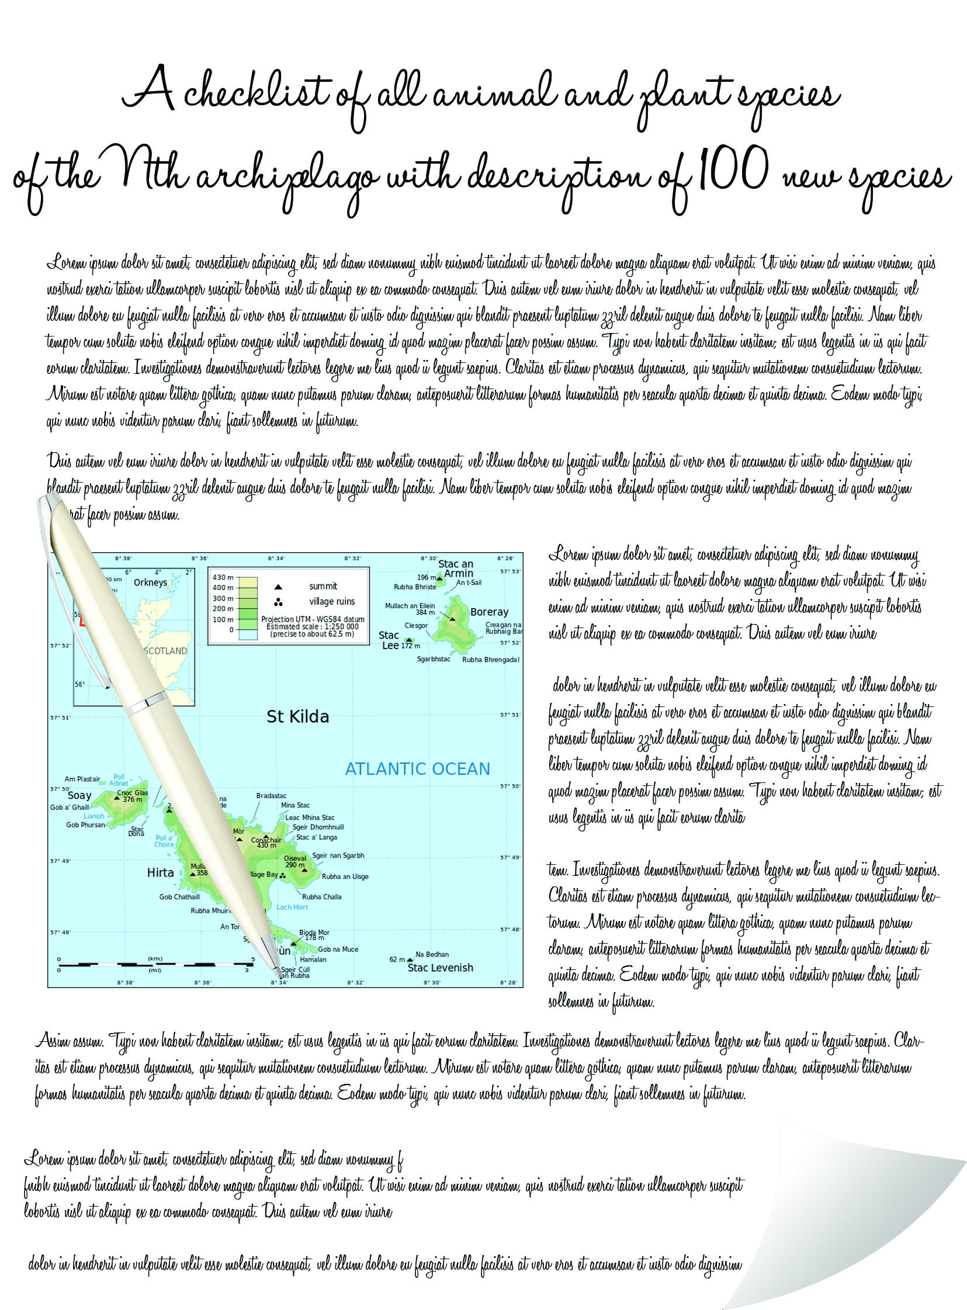

Slide 12
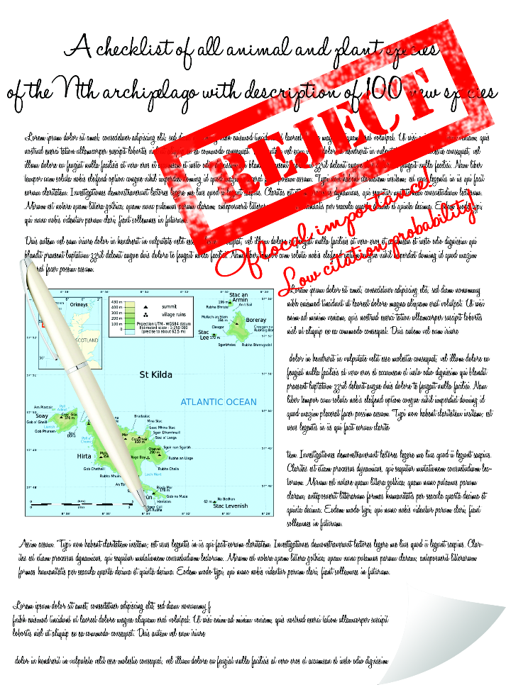

Slide 13
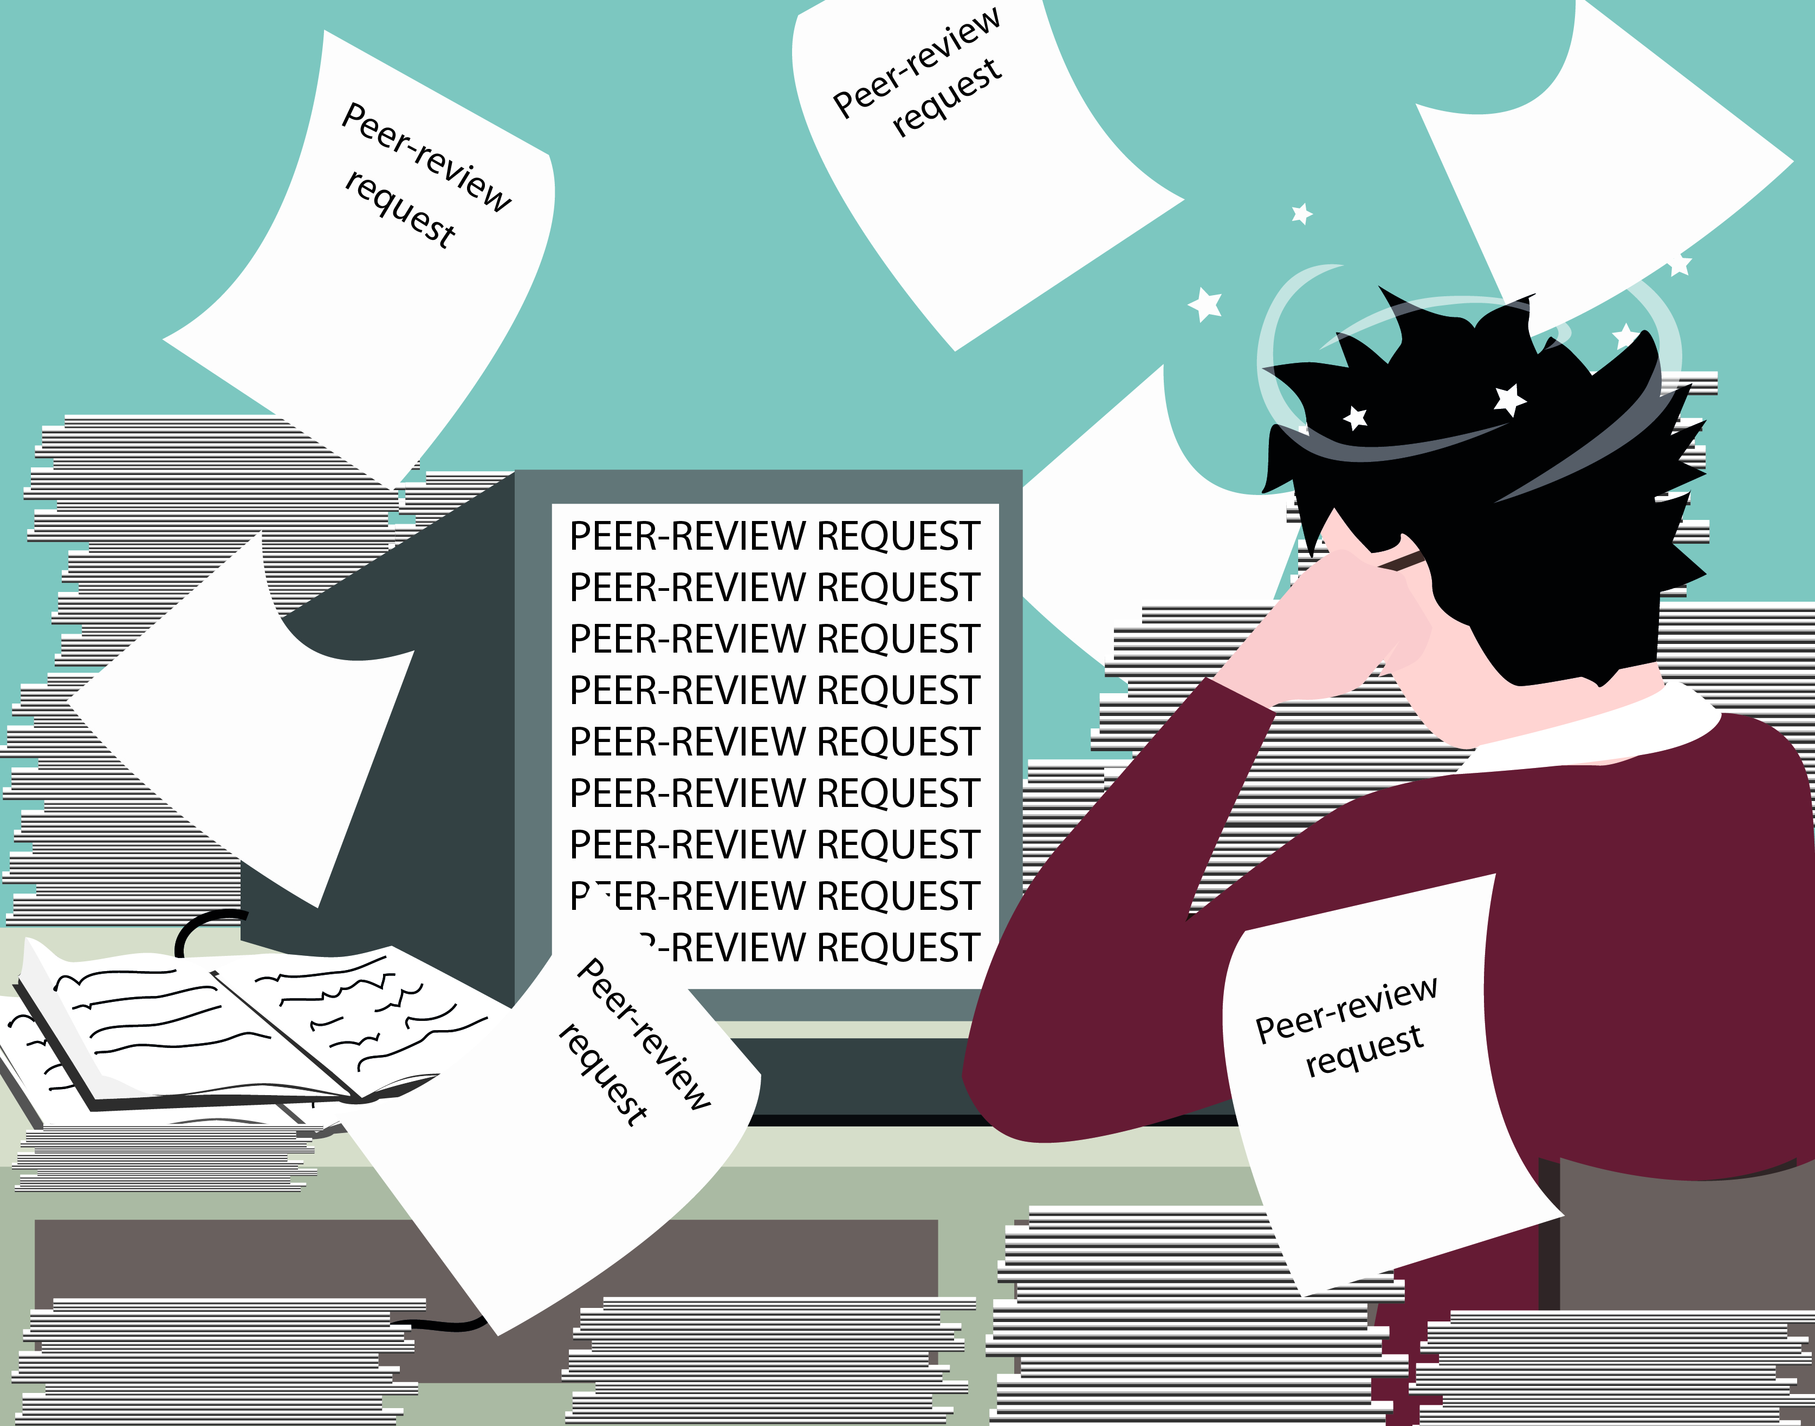
The “peer review” pressure

Slide 14
The solution?

Slide 15
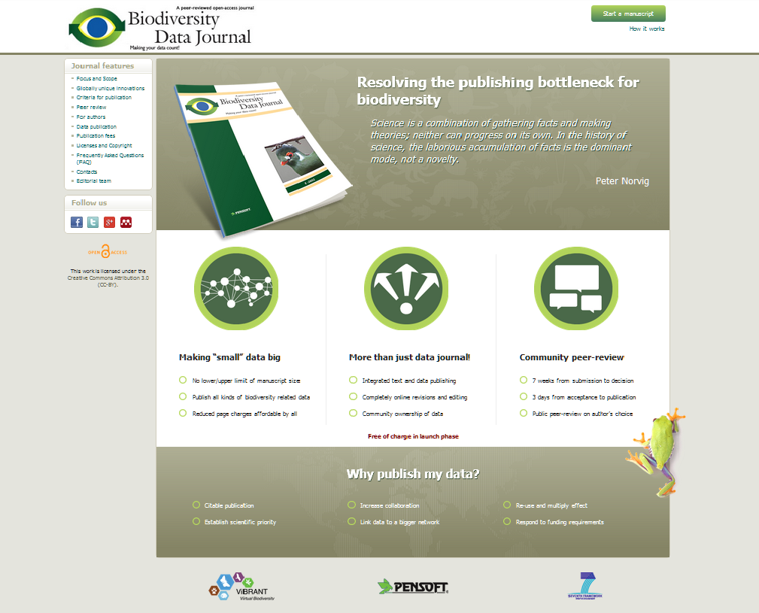

Slide 16
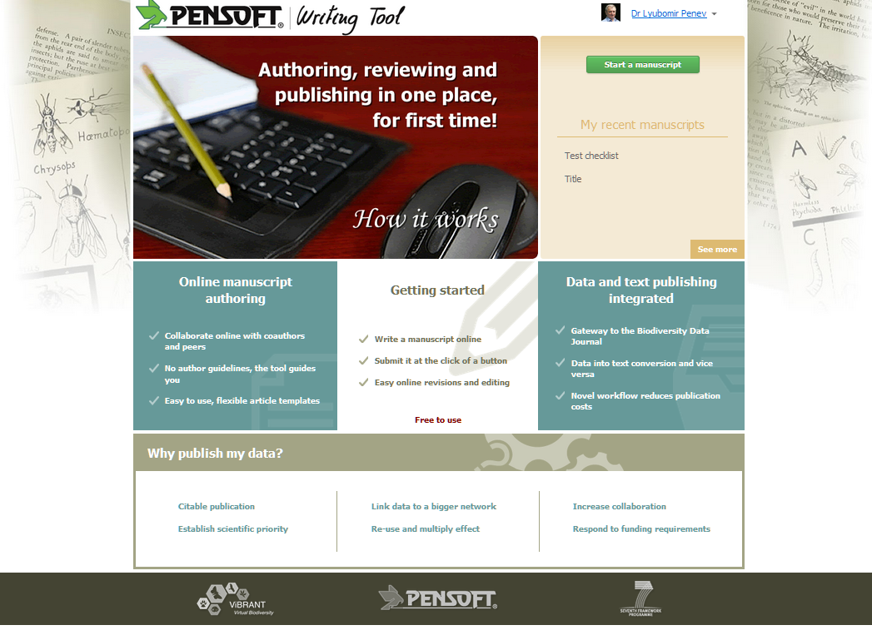

Slide 17

Launch date http://biodiversitydatajournal.com

Slide 18

Novel concepts
Authoring, reviewing and publishing in one place, for first time!
Upfront markup!
“Small” data imported in and downloadable from text
Large datasets published as data papers
Text stored and treated as data
Community peer-reviewed and community owned interoperable data
Text and data integrated publishing!

Slide 19







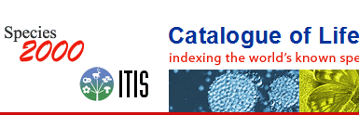

How BDJ does that?
Collaborative
ARTICLE AUTHORING
(PENSOFT WRITING
TOOL)
Automatedsubmission
Community peer-review
(options for public and
Open review)
ALL ONLINE!
Revisions
online
Authors, Reviewers, Editors, Mentors, Copyeditors
MANUSCRIPT published
XML text + data
ARTICLES
Biblio-
graphies
Occurr-
ence data
Taxon treatments
Taxon names
Plazi
Wiki
COL

Slide 20
Novel work flows
Authoring
Peer-review
Publishing and dissemination

Slide 21
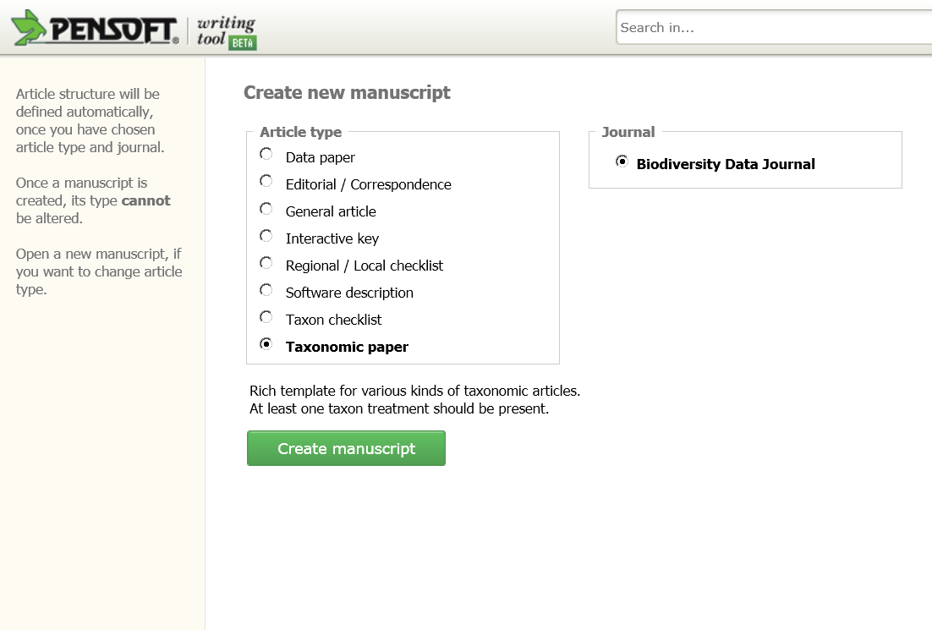
Article templates

Slide 22
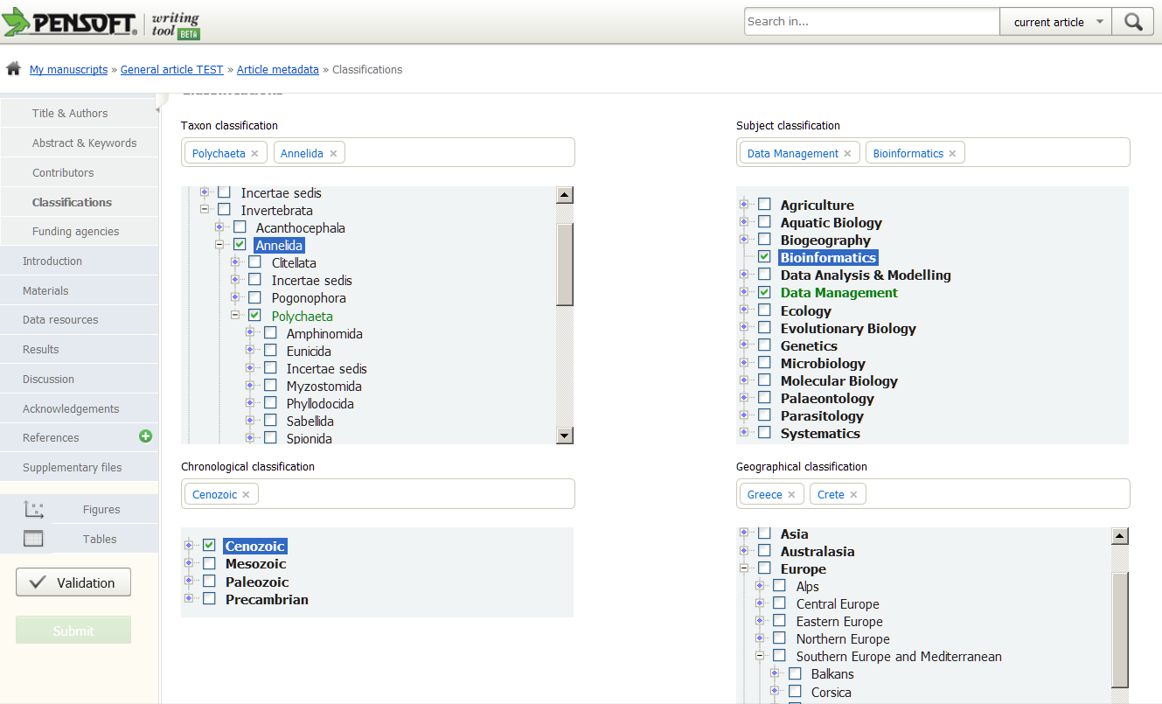
Classifications

Slide 23
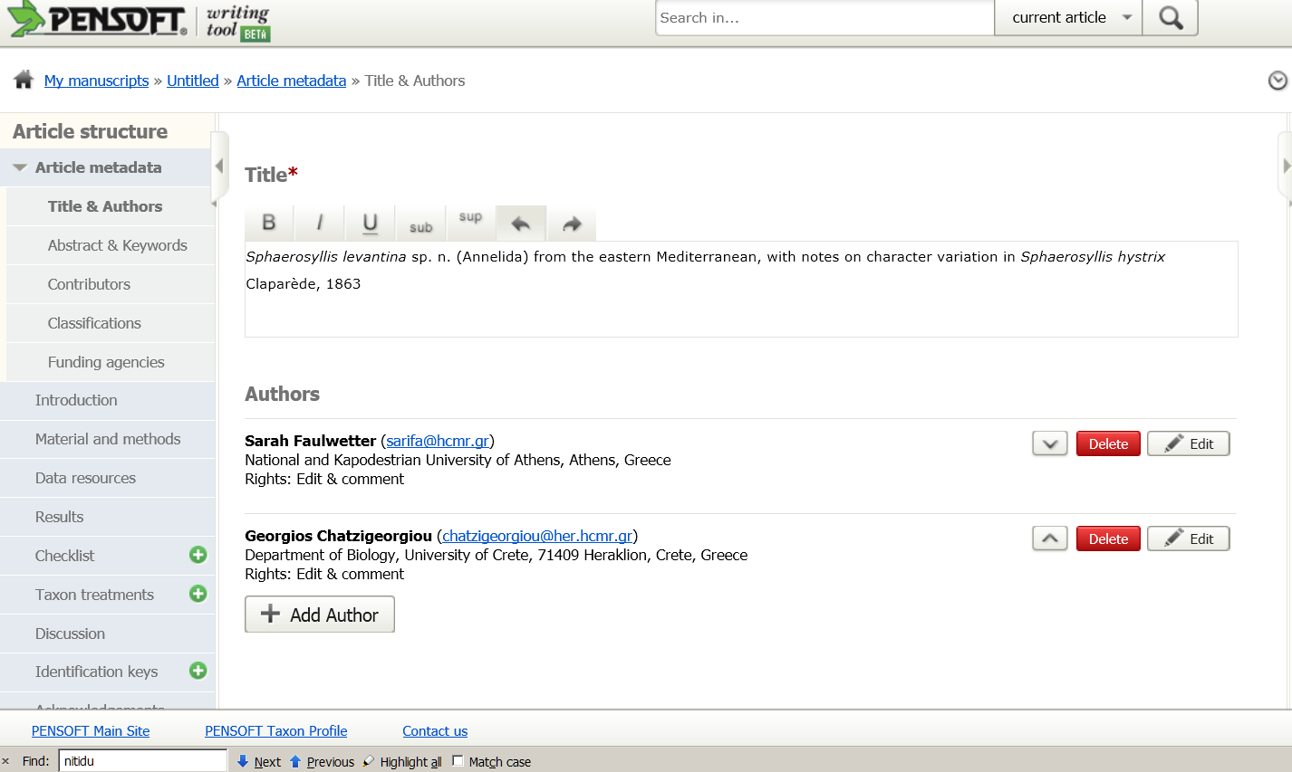
Invite co-authors

Slide 24
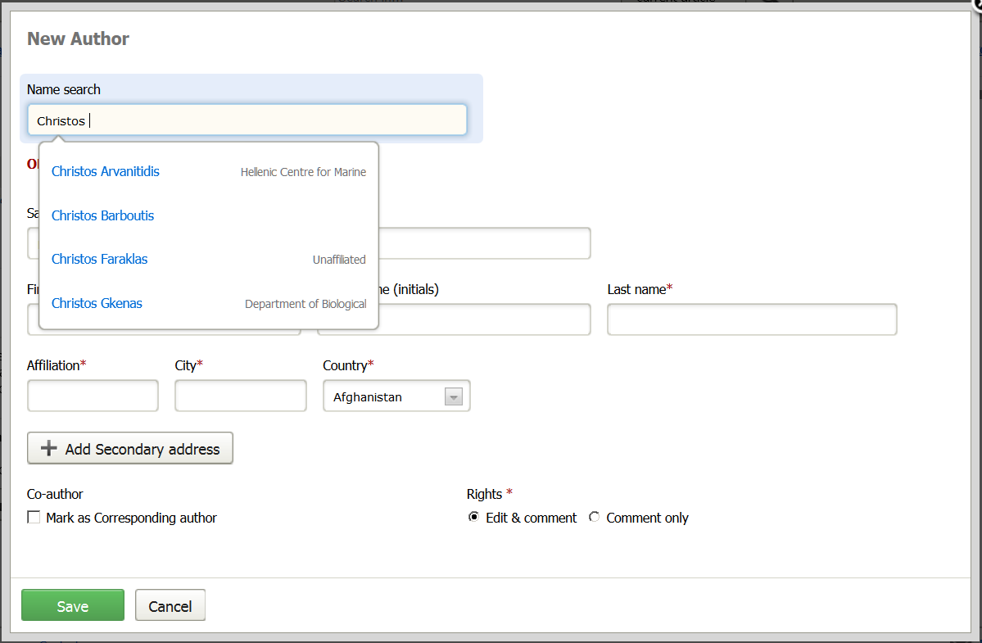
Import co-author’s profile

Slide 25
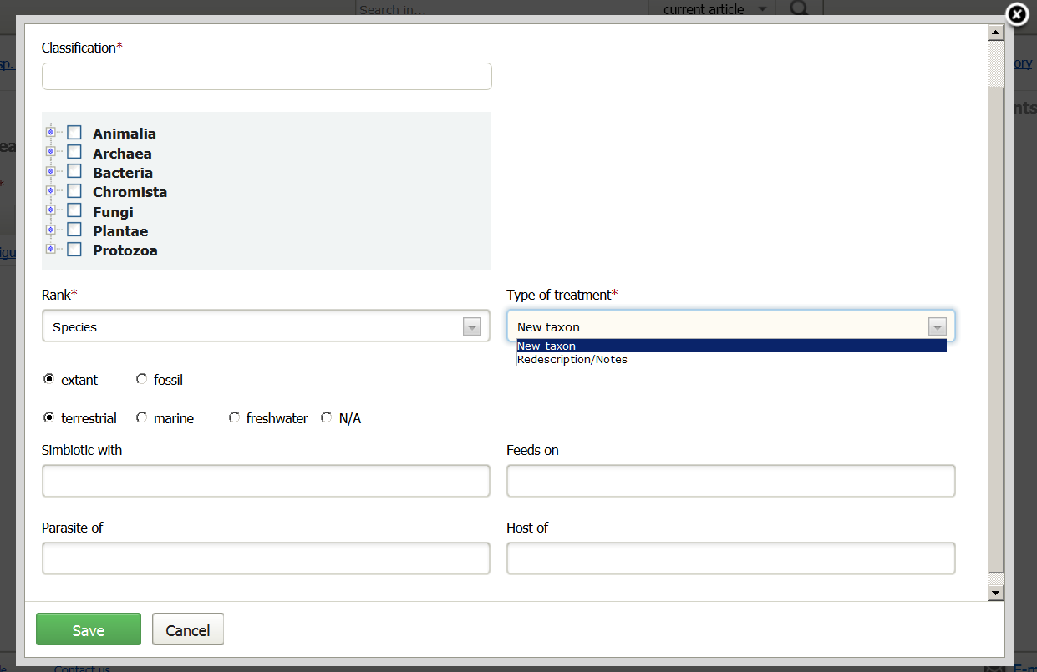
Describe new taxon

Slide 26
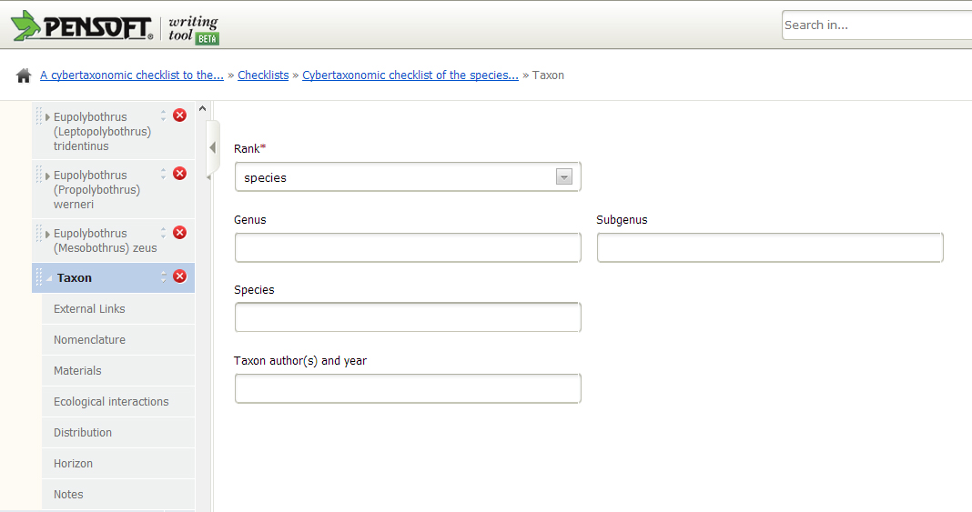
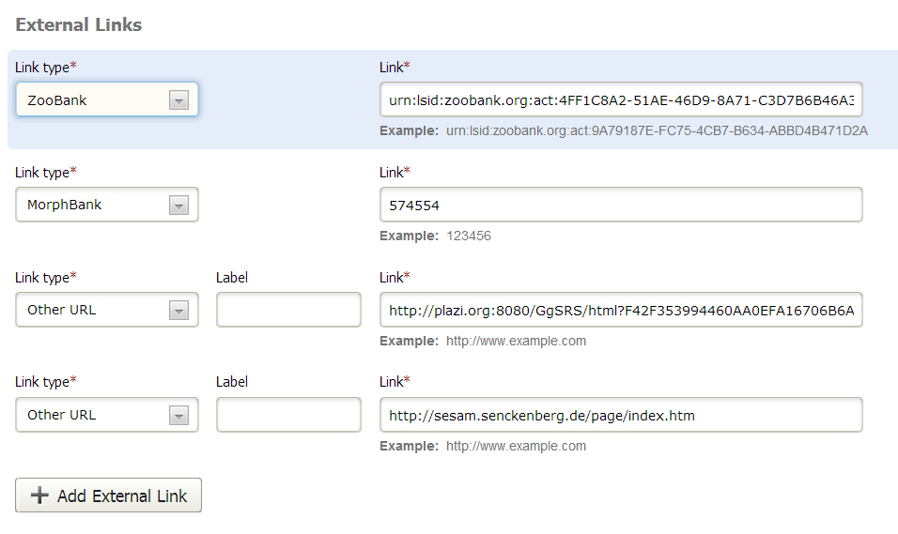
Structure of the checklist filed
External links

Slide 27
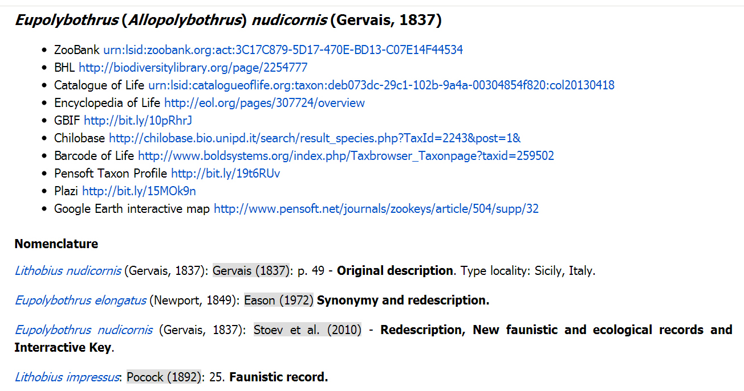
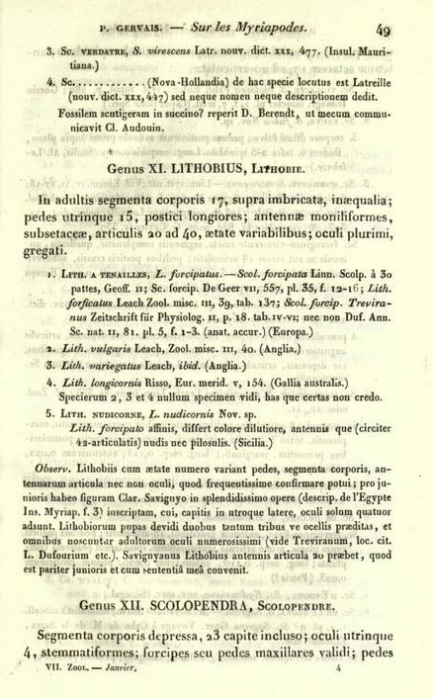
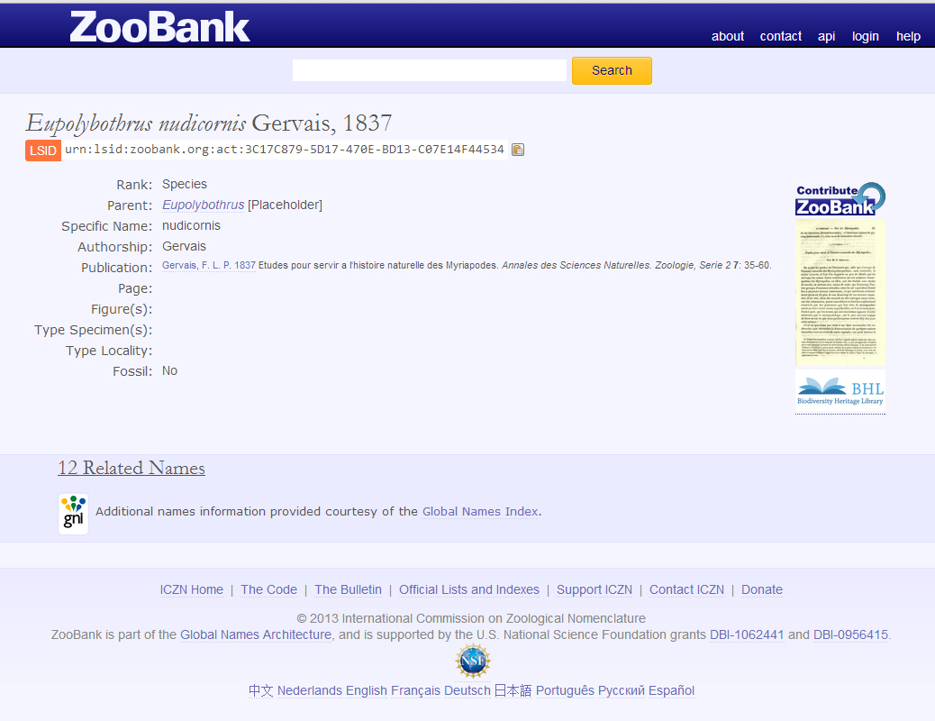
External links

Slide 28
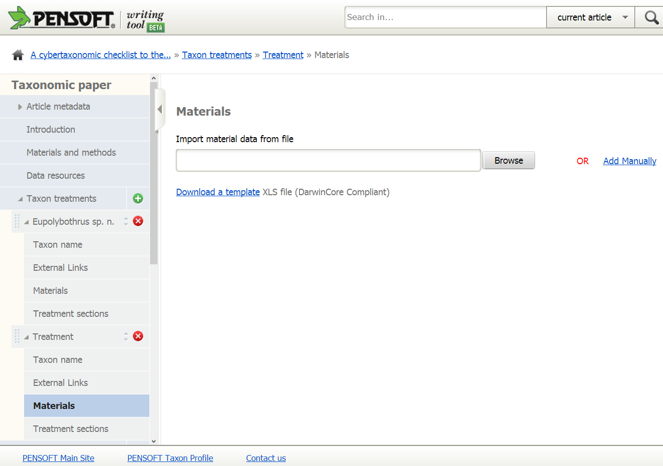
Import DwC data

Slide 29
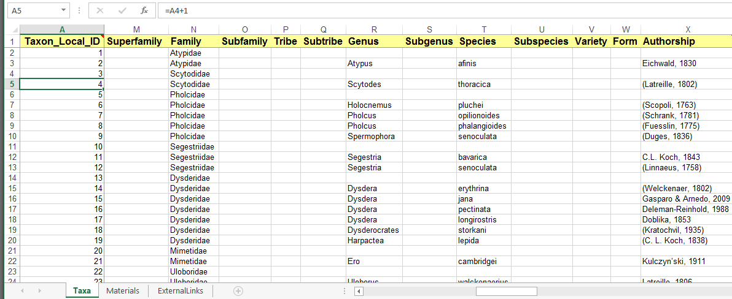
DwC Template

Slide 30
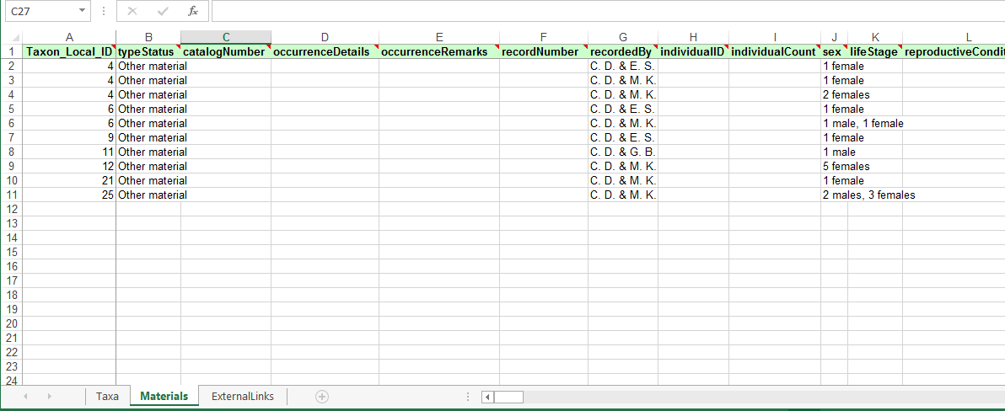
DwC Template

Slide 31
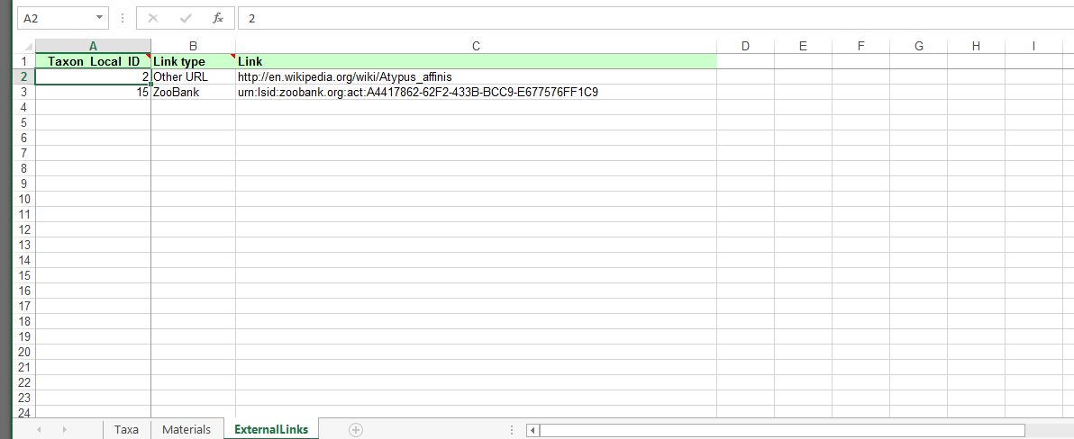
DwC Template

Slide 32
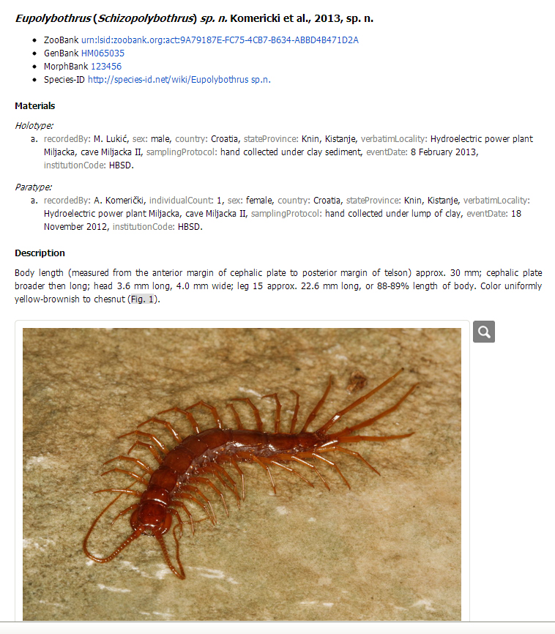
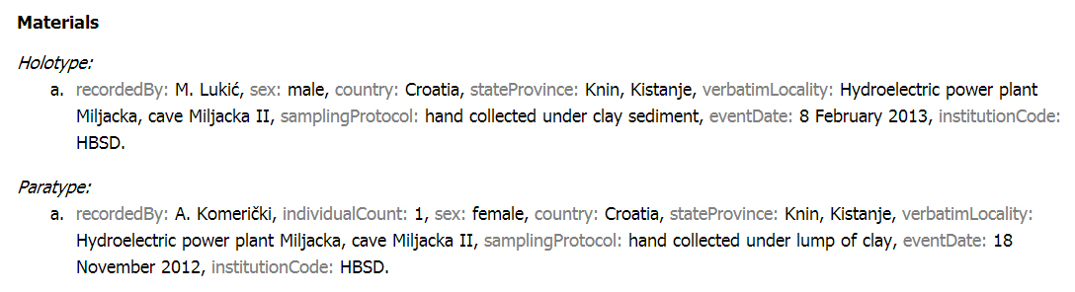
DwC terms visible in text

Slide 33
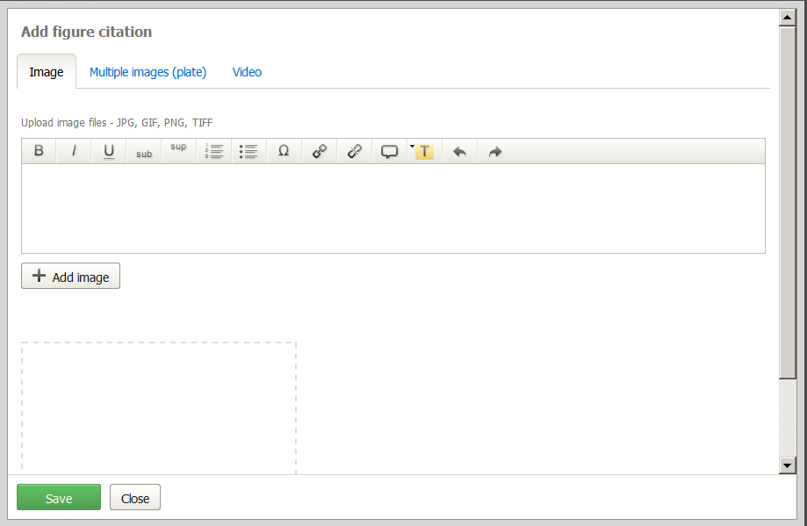
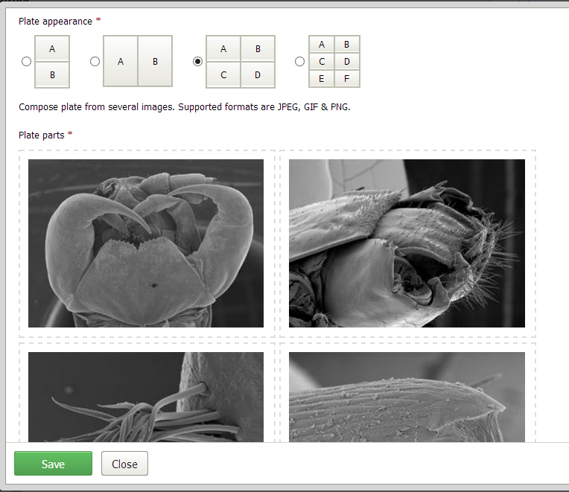
Compose plates

Slide 34
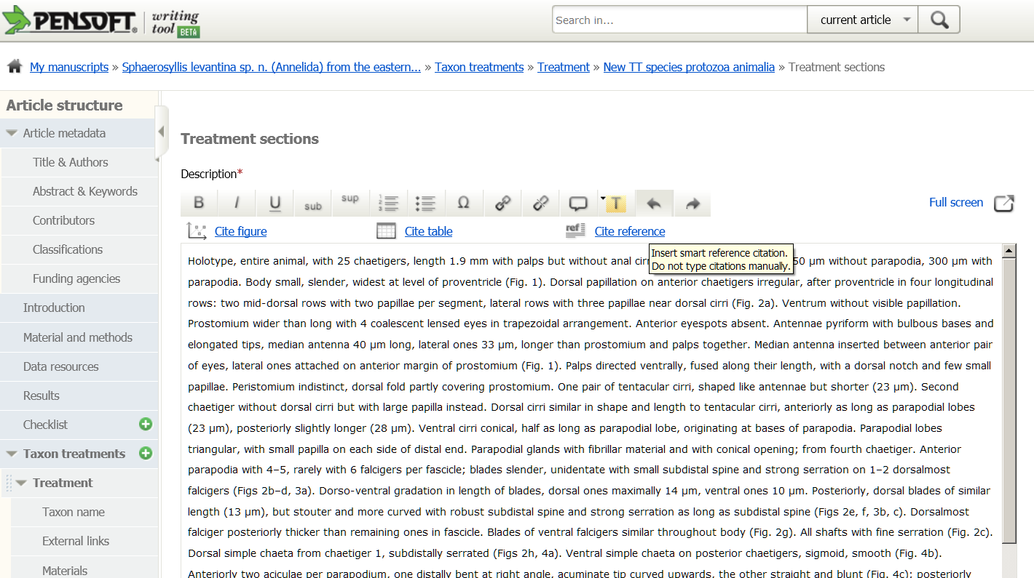

Slide 35
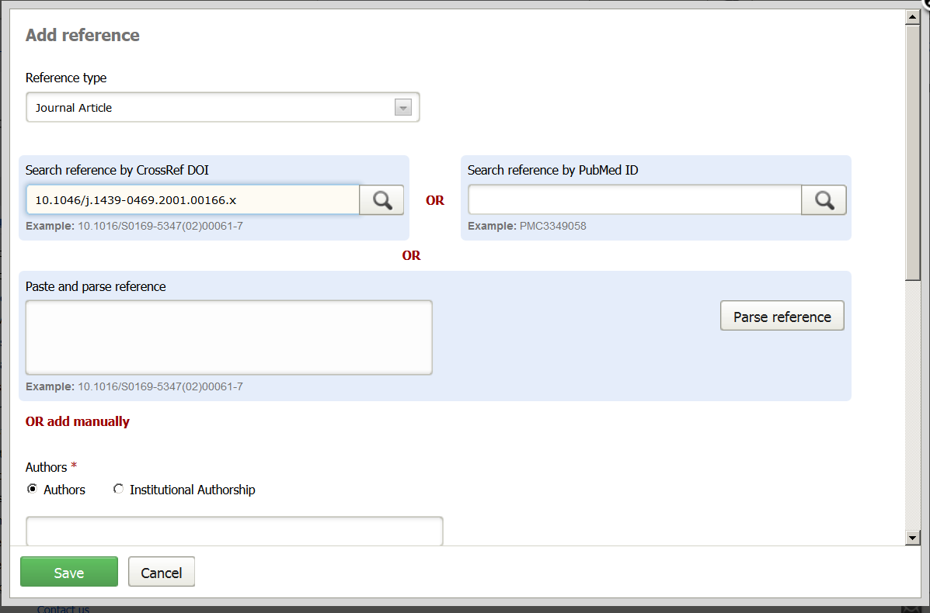
Pick up a reference

Slide 36
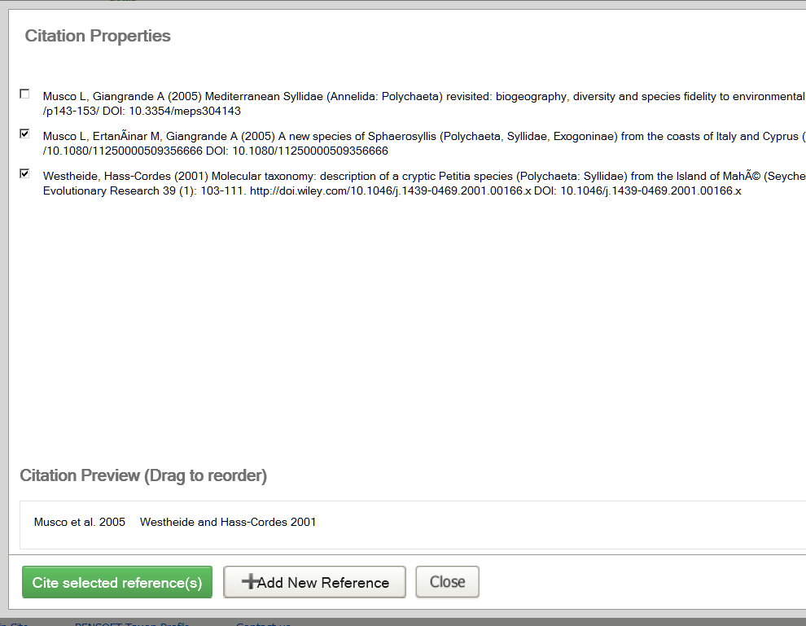
Cite a reference

Slide 37
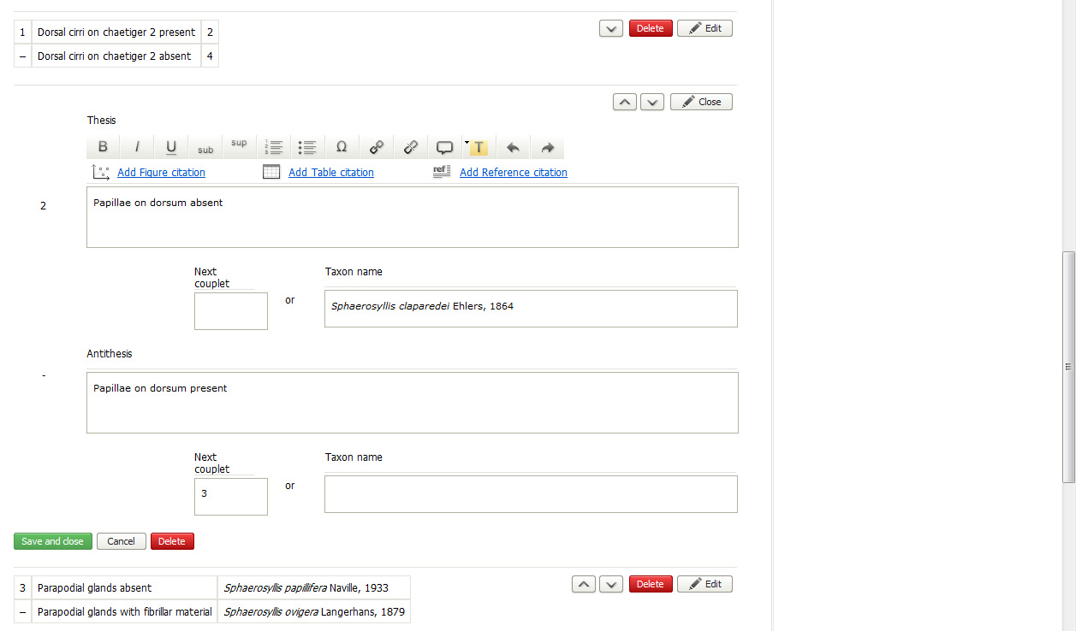
Construction
of keys

Slide 38
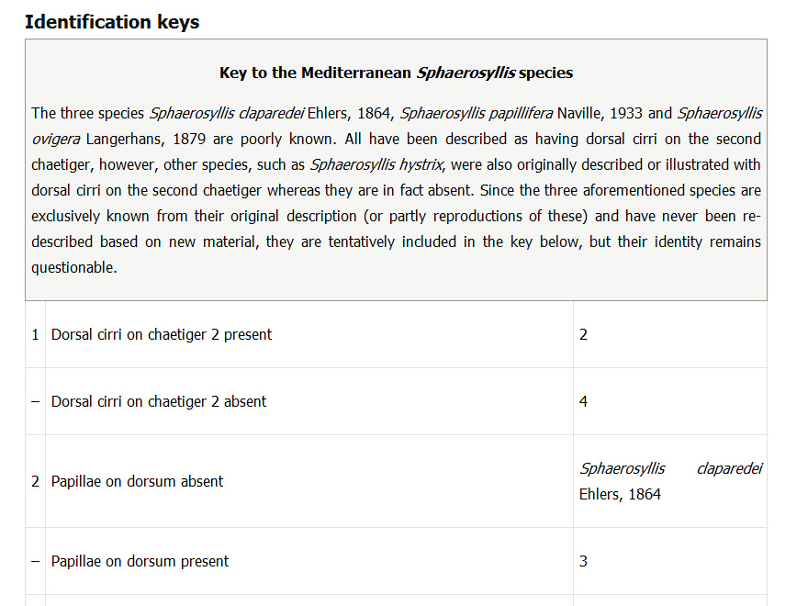
Key preview

Slide 39
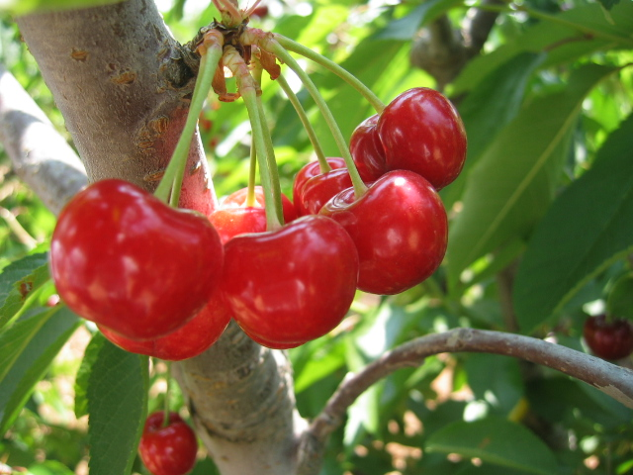

Slide 40
No author guidelines! The tool will guide you!

Slide 41
Authors do not need to markup or hyperlink anything!
It is done by the tool!

Slide 42
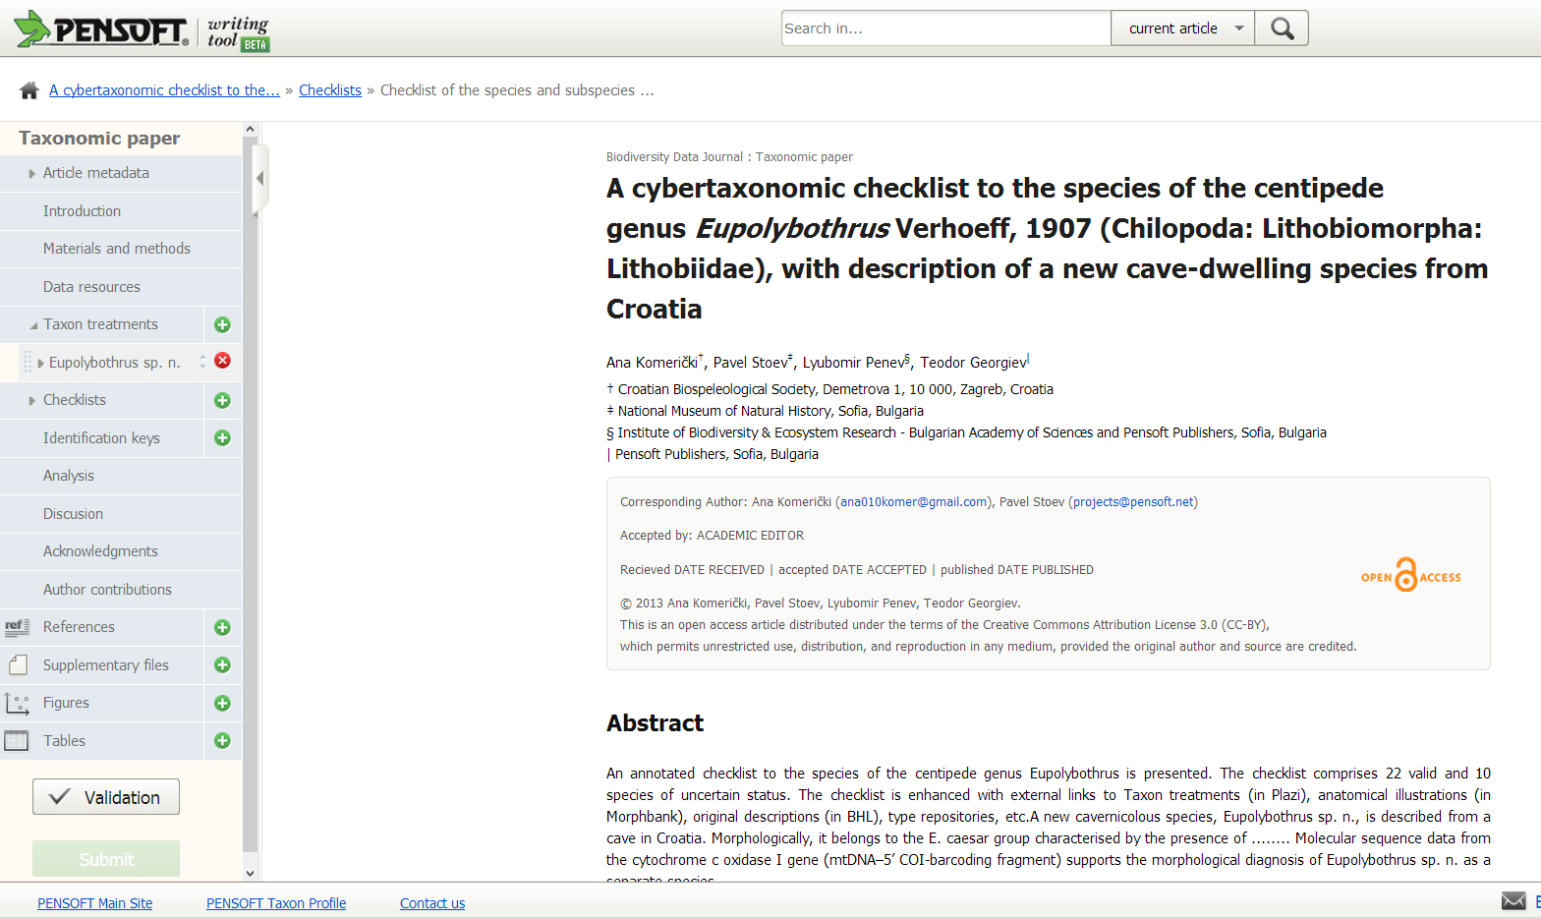
No layout stage!

Slide 43
Novel work flows
Authoring
Peer-review
Publishing and dissemination

Slide 44
Community and public peer-review
Notes:
44
Slide 12: Next generation article publishing
Arguably our most ambitious developments in the context of scholarly communication concern the semi-automated construction of scholarly papers from databases. In many cases Scratchpads contain extensive data relating to the biology and description of particular species. These are highly suited to formal specialist publications, but doing so require the laborious assembly of these data into a manuscript. As part of the ViBRANT collaboration with Pensoft, and in particular their two journals specialising in the formal taxonomic descriptions of plants and animals, we have developed a 5-step workflow for users to selecting appropriate data from their Scratchpad, adding additional metadata describing this information so that it conforms with the norms of descriptive taxonomic publications, and then finally preview and submit this manuscript to the publisher. From here is goes through a standard peer review process. Review recommendations are then incorporated in to a revised version of the manuscript, which is then sent back to the publisher and simultaneously published on both the Scratchpad and in the publisher’s journal.
In addition to dramatically speeding up the construction of scientific papers, the user has the advantage that firstly the manuscript can be revised and updated and new information comes to light on the Scratchpad, while preserving the original version of the manuscript as part of the scholarly record. In addition the publish extracts relevant information from the submitted database which is them automatically submitted to the specialist data repositories.
So in sum then, these are the four ways in which ViBRANT is facilitation scholarly communication of biodiversity information. 1) Through low cost journal infrastructure; 2) by community web publishing; 3) by biodiversity observation data publishing; and 4) by next generation publishing services producing scholarly articles from databases.

Slide 45
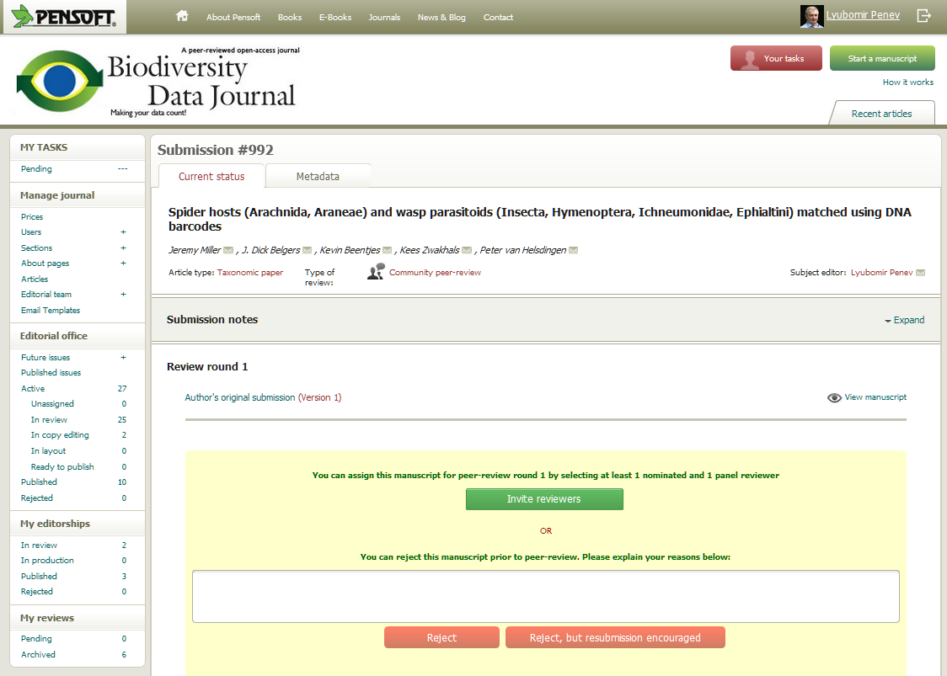

Slide 46
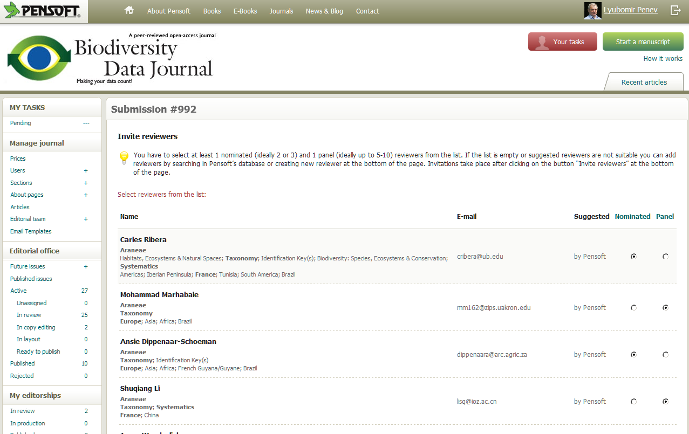

Slide 47
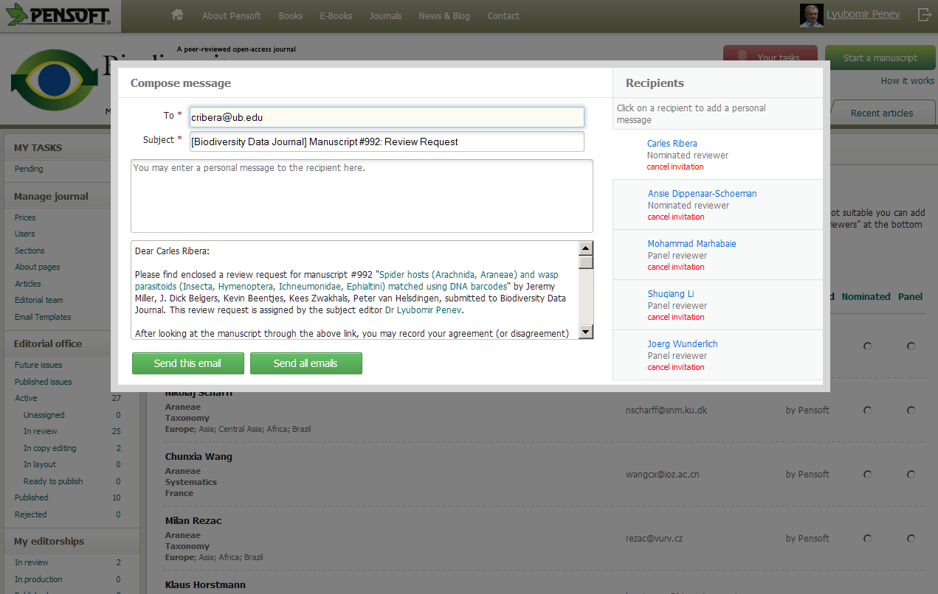
Now imagine…

Slide 48
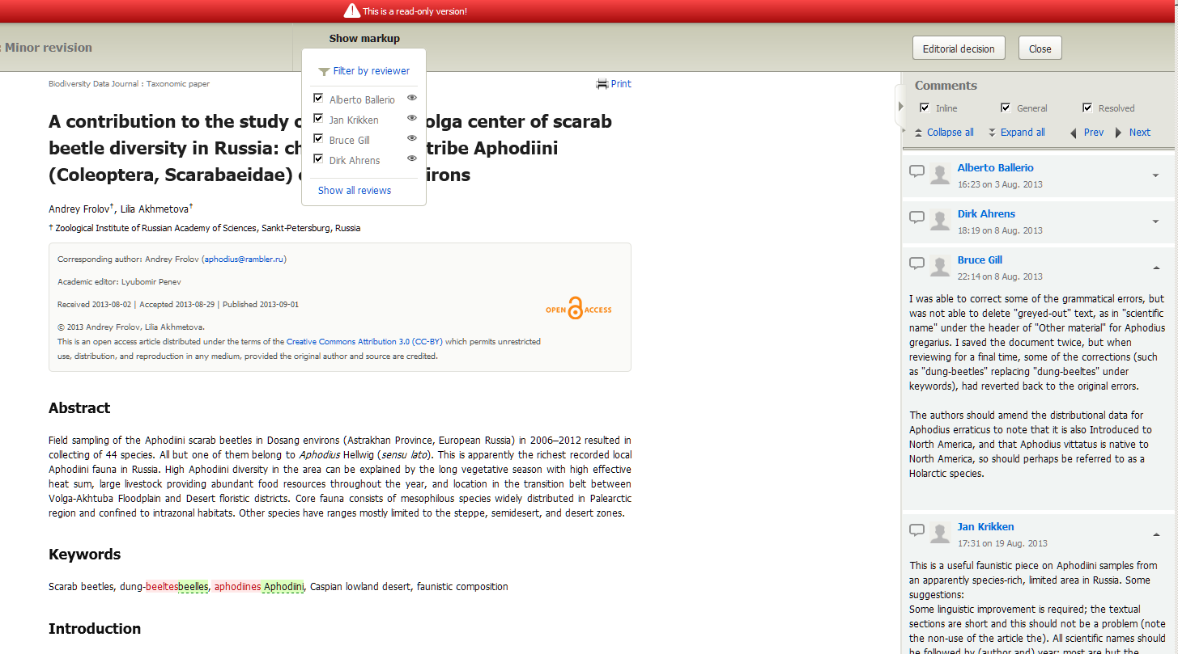
Consolidated Reviewers’ Version

Slide 49
Novel work flow
Authoring
Peer-review
Publishing and dissemination

Slide 50
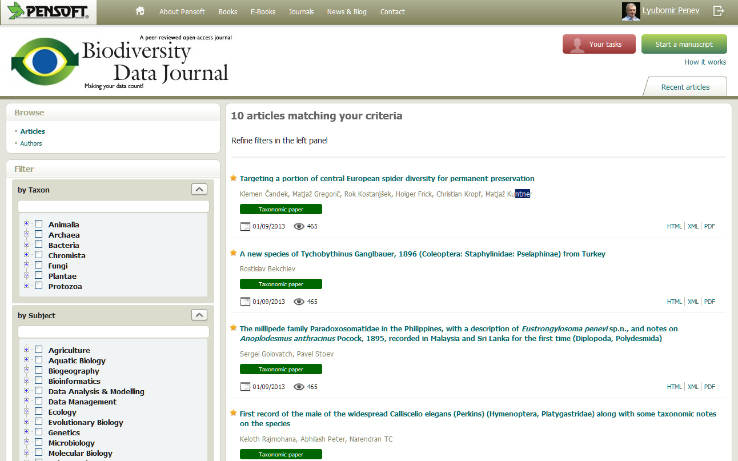

Slide 51
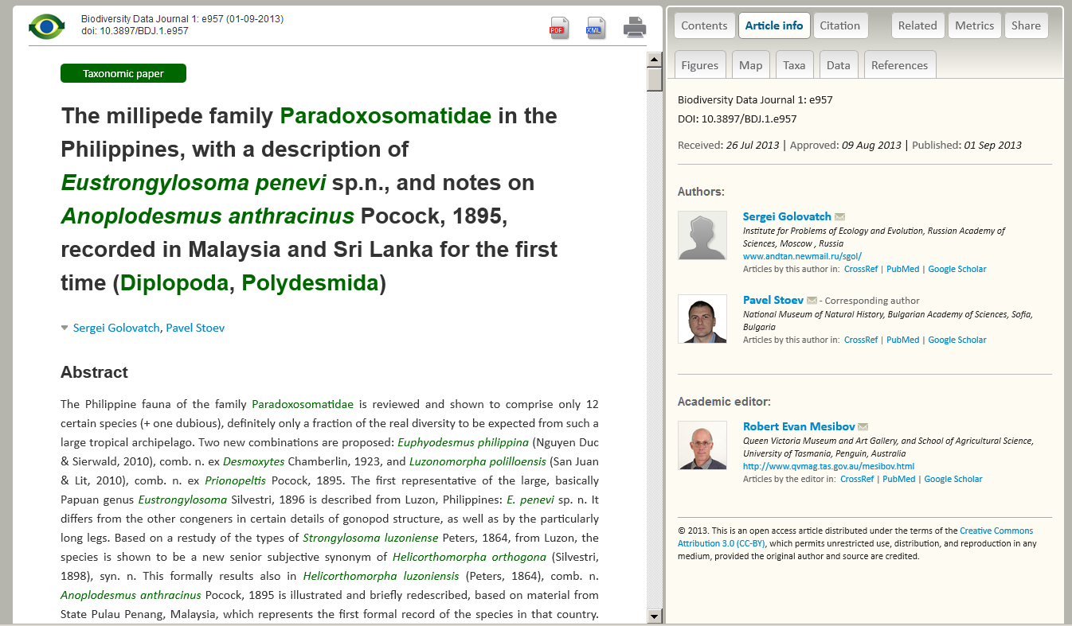
Article metadata

Slide 52
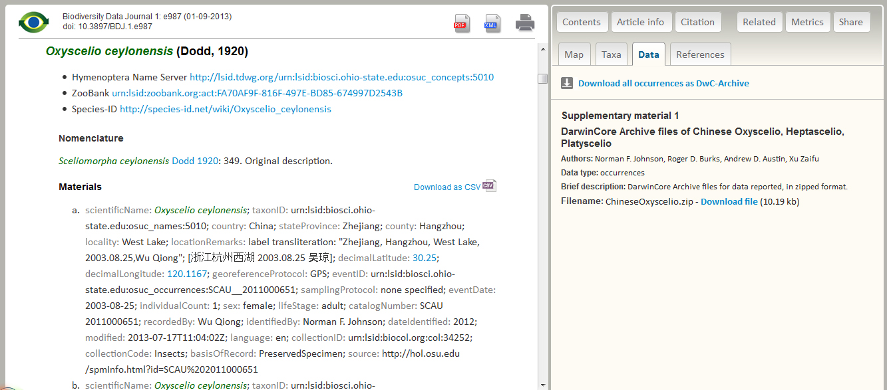
Download data

Slide 53
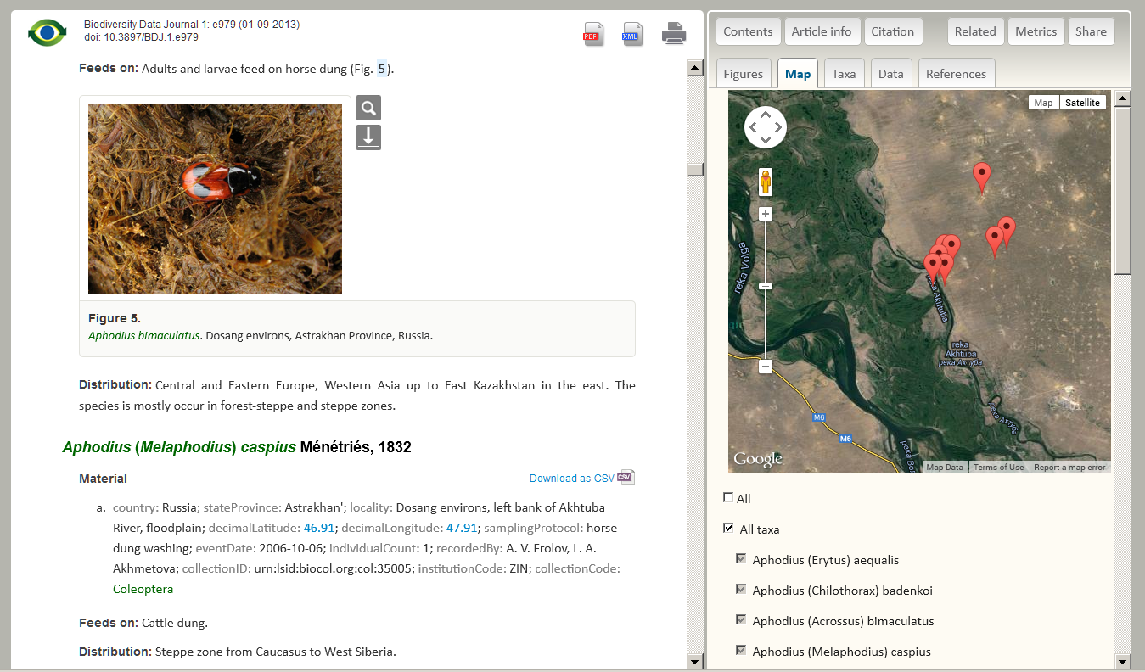
Map localities

Slide 54
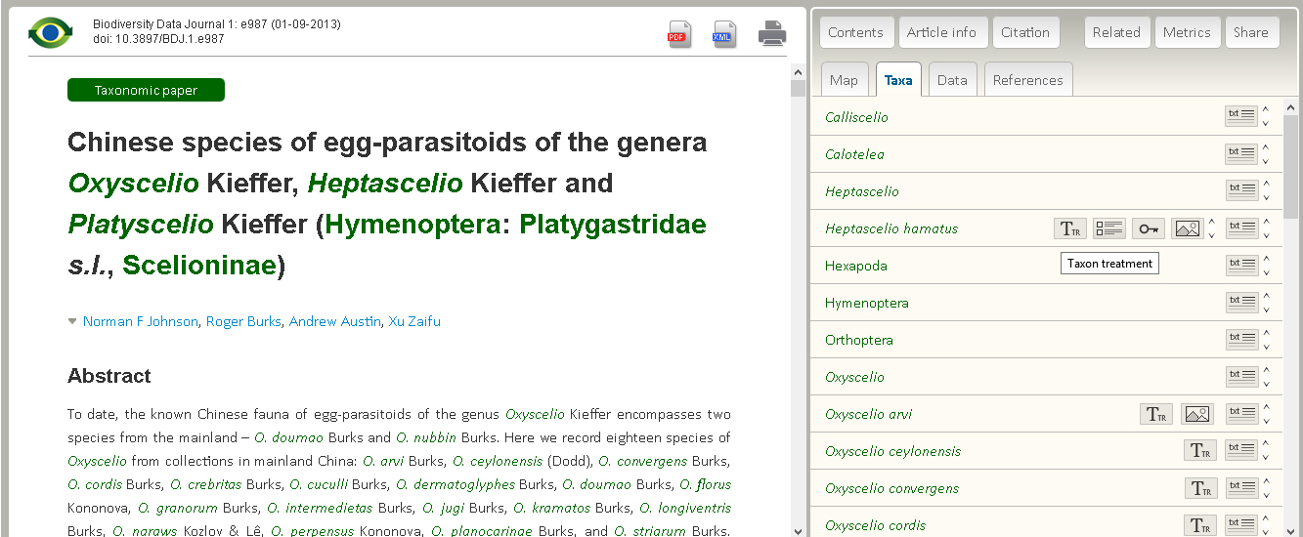
Taxa and their usages

Slide 55
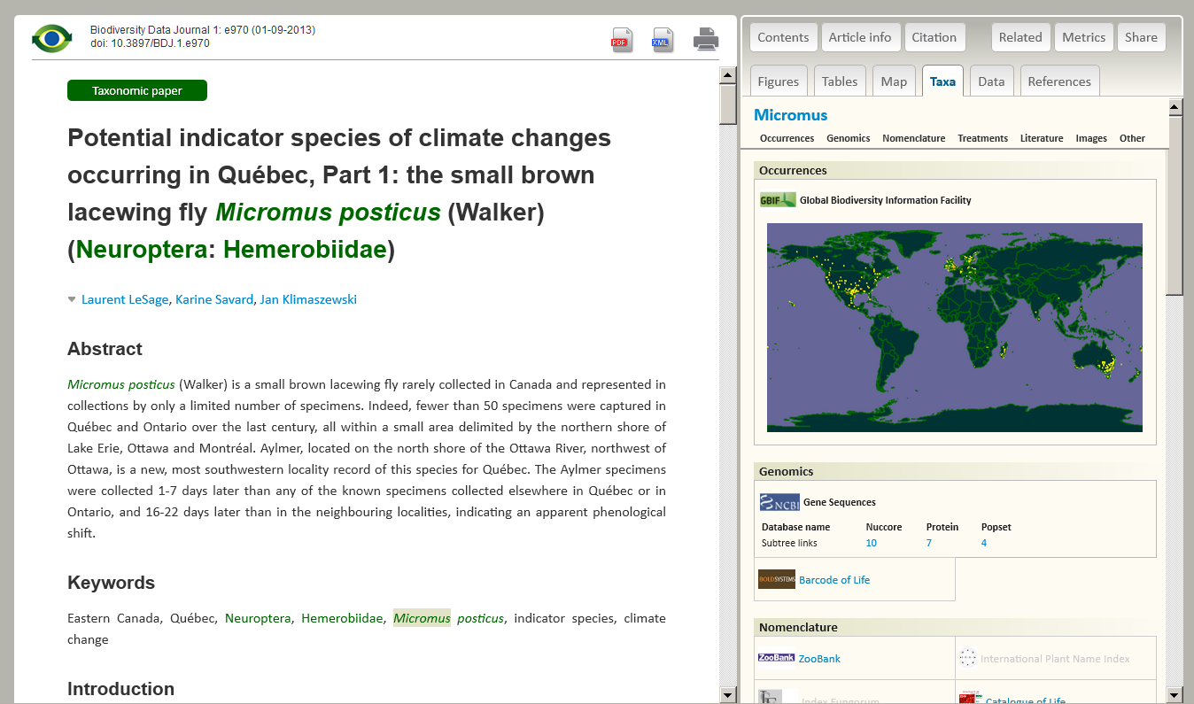
Taxon profile

Slide 56
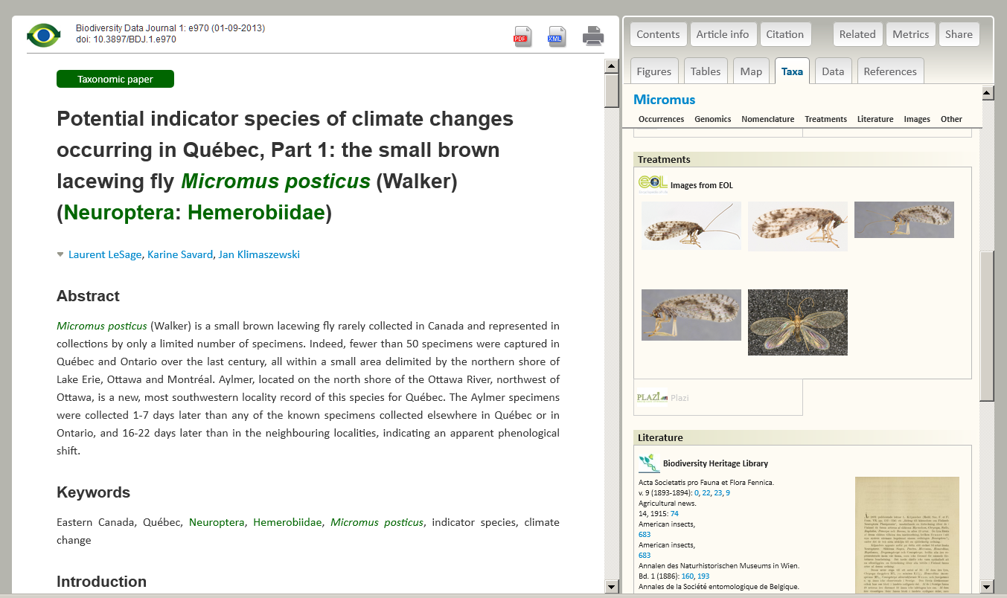
Taxon profile

Slide 57
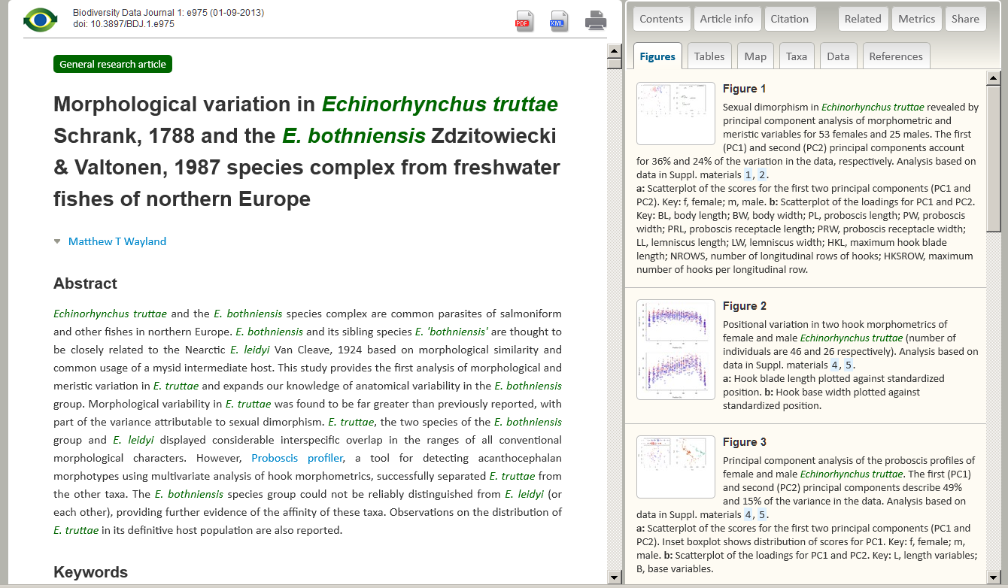
Tables and Figures

Slide 58
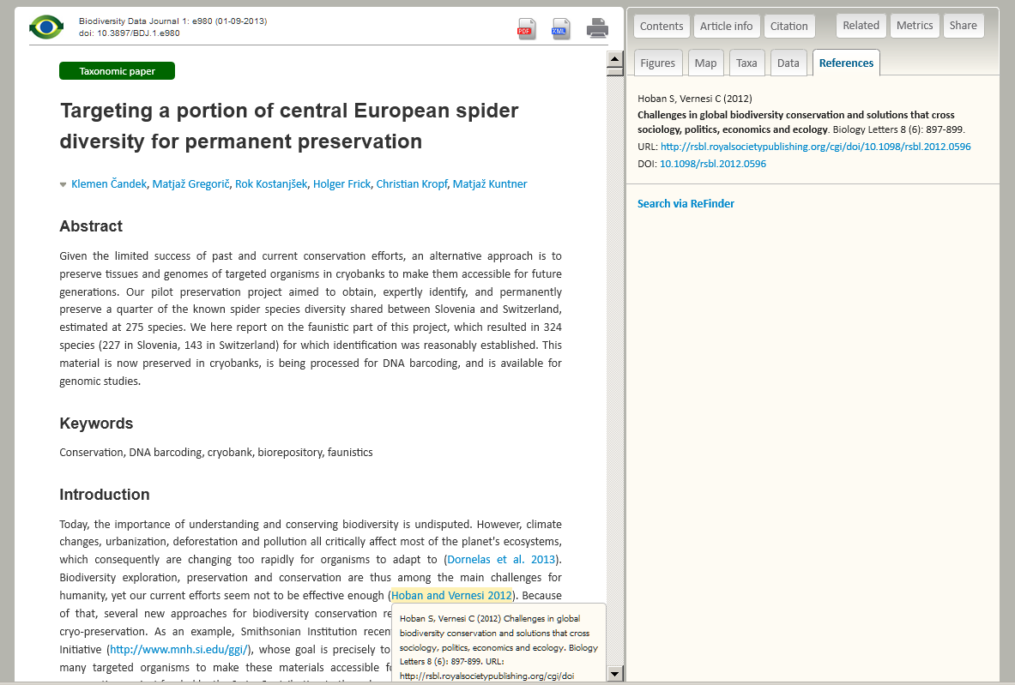
References

Slide 59


Slide 60


Slide 61

Possible solution for “dark” taxa
Pwt – collaborative
article authoring tool
Dark taxon sequenced
manuscript finalization
& SUBMISSION
Automated submission to Pensoft Writing Tool
Bdj – peer-review
BOLD Metadata:
voucher specimen,
images, locality, etc.
MANUSCRIPT
PUBLISHED
Automated update of bibliographic metadata, taxon names, Zoobank records, etc.

Slide 62



Automated pre-publication registration of new taxon names
Manuscript
SUBMISSION
Peer review
XML Query
MANUSCRIPT
ACCEPTED
XML Response
XML article metadata
ARTICLE
PUBLISHED
Taxon name available/valid
(effectively published)

Slide 63
Re-publishing of legacy literature
PROSPECTIVE PUBLISHING | HISTORICAL LITERATURE
PENSOFT
WRITING TOOL
XML IMPORT
OCR, re-typing, markup,
extracting images , tables
Content management systems &
repositories (SCRATCHPADS, CDM, etc.)
2nd DIGITAL EDITION
semantically enhanced
HTML and XML
Unified marked up final output
Taxon treatments, keys, images, localities, references
archiving
END
USERS
Electronic
archives; Data
Centers
Species-ID,
Wikispecies
Wikipedia
Indexing (IPNI,
ZooBank, Myco-
Bank, GNA)
Aggregators
(EOL, GBIF)

Slide 64

What will BDJ publish?
Single taxon treatments and acts
Local/regional and habitat checklists, sampling reports, N2K inventories
Ecological and biological observations on species and communities
Identification keys
Data papers describing data
Descriptions of software tools and work flows
Recruiting editors!
Editor Application Form http://pensoft.net/journals/bdj/editor_form.html
Notes:
64
Slide 12: Next generation article publishing
Arguably our most ambitious developments in the context of scholarly communication concern the semi-automated construction of scholarly papers from databases. In many cases Scratchpads contain extensive data relating to the biology and description of particular species. These are highly suited to formal specialist publications, but doing so require the laborious assembly of these data into a manuscript. As part of the ViBRANT collaboration with Pensoft, and in particular their two journals specialising in the formal taxonomic descriptions of plants and animals, we have developed a 5-step workflow for users to selecting appropriate data from their Scratchpad, adding additional metadata describing this information so that it conforms with the norms of descriptive taxonomic publications, and then finally preview and submit this manuscript to the publisher. From here is goes through a standard peer review process. Review recommendations are then incorporated in to a revised version of the manuscript, which is then sent back to the publisher and simultaneously published on both the Scratchpad and in the publisher’s journal.
In addition to dramatically speeding up the construction of scientific papers, the user has the advantage that firstly the manuscript can be revised and updated and new information comes to light on the Scratchpad, while preserving the original version of the manuscript as part of the scholarly record. In addition the publish extracts relevant information from the submitted database which is them automatically submitted to the specialist data repositories.
So in sum then, these are the four ways in which ViBRANT is facilitation scholarly communication of biodiversity information. 1) Through low cost journal infrastructure; 2) by community web publishing; 3) by biodiversity observation data publishing; and 4) by next generation publishing services producing scholarly articles from databases.

Slide 65
Why publish in BDJ?
Not just a journal
Even not just a data journal!
A work flow and infrastructure to mobilize, review, publish, store, disseminate, make interoperable, collate and re-use data
through the act of publishing!
Notes:
65
Slide 12: Next generation article publishing
Arguably our most ambitious developments in the context of scholarly communication concern the semi-automated construction of scholarly papers from databases. In many cases Scratchpads contain extensive data relating to the biology and description of particular species. These are highly suited to formal specialist publications, but doing so require the laborious assembly of these data into a manuscript. As part of the ViBRANT collaboration with Pensoft, and in particular their two journals specialising in the formal taxonomic descriptions of plants and animals, we have developed a 5-step workflow for users to selecting appropriate data from their Scratchpad, adding additional metadata describing this information so that it conforms with the norms of descriptive taxonomic publications, and then finally preview and submit this manuscript to the publisher. From here is goes through a standard peer review process. Review recommendations are then incorporated in to a revised version of the manuscript, which is then sent back to the publisher and simultaneously published on both the Scratchpad and in the publisher’s journal.
In addition to dramatically speeding up the construction of scientific papers, the user has the advantage that firstly the manuscript can be revised and updated and new information comes to light on the Scratchpad, while preserving the original version of the manuscript as part of the scholarly record. In addition the publish extracts relevant information from the submitted database which is them automatically submitted to the specialist data repositories.
So in sum then, these are the four ways in which ViBRANT is facilitation scholarly communication of biodiversity information. 1) Through low cost journal infrastructure; 2) by community web publishing; 3) by biodiversity observation data publishing; and 4) by next generation publishing services producing scholarly articles from databases.

Slide 66
Implementation in other domains
welcome!
Notes:
66
Slide 12: Next generation article publishing
Arguably our most ambitious developments in the context of scholarly communication concern the semi-automated construction of scholarly papers from databases. In many cases Scratchpads contain extensive data relating to the biology and description of particular species. These are highly suited to formal specialist publications, but doing so require the laborious assembly of these data into a manuscript. As part of the ViBRANT collaboration with Pensoft, and in particular their two journals specialising in the formal taxonomic descriptions of plants and animals, we have developed a 5-step workflow for users to selecting appropriate data from their Scratchpad, adding additional metadata describing this information so that it conforms with the norms of descriptive taxonomic publications, and then finally preview and submit this manuscript to the publisher. From here is goes through a standard peer review process. Review recommendations are then incorporated in to a revised version of the manuscript, which is then sent back to the publisher and simultaneously published on both the Scratchpad and in the publisher’s journal.
In addition to dramatically speeding up the construction of scientific papers, the user has the advantage that firstly the manuscript can be revised and updated and new information comes to light on the Scratchpad, while preserving the original version of the manuscript as part of the scholarly record. In addition the publish extracts relevant information from the submitted database which is them automatically submitted to the specialist data repositories.
So in sum then, these are the four ways in which ViBRANT is facilitation scholarly communication of biodiversity information. 1) Through low cost journal infrastructure; 2) by community web publishing; 3) by biodiversity observation data publishing; and 4) by next generation publishing services producing scholarly articles from databases.

Slide 67

LOW COST!

Slide 68


Slide 69

I Open Access!
and….
ViBRANT
PLAZI

Slide 70


Drawings: slavenapeneva.com

